Slide 1
Agreement and case in the Caucasus
Matthew Zaslansky
University of California, San Diego
LIGN 120
Notes:
Talk about the proposal in the first slide. Overabundance. Talk about Johanson in the first slide.
And then show all the allomorphy after the…
Move Uyghur/Azerbaijani before the paradigmatic organization.
Talk about Maslova at the beginning.
Talk about why using Maslovian dynamic typology.

Slide 2
Case and agreement
“What's the difference between case and agreement?”
Sharon write-s to me Sharon write-3SG to 1SG.ACC

Slide 3
Case and agreement
“What's the difference between case and agreement?”
Sharon write-s to me Sharon.NOM write-3SG to 1SG.ACC
Case marks arguments.

Slide 4
Case and agreement
“What's the difference between case and agreement?”
Sharon write-s to me Sharon.NOM write-3SG to 1SG.ACC
Case marks arguments.
Agreement marks verbs.

Slide 5
Case and agreement
“What's the difference between case and agreement?”
Sharon write-s to me Sharon.NOM write-3SG to 1SG.ACC
Case marks arguments.
Agreement marks verbs.
…usually…

Slide 6
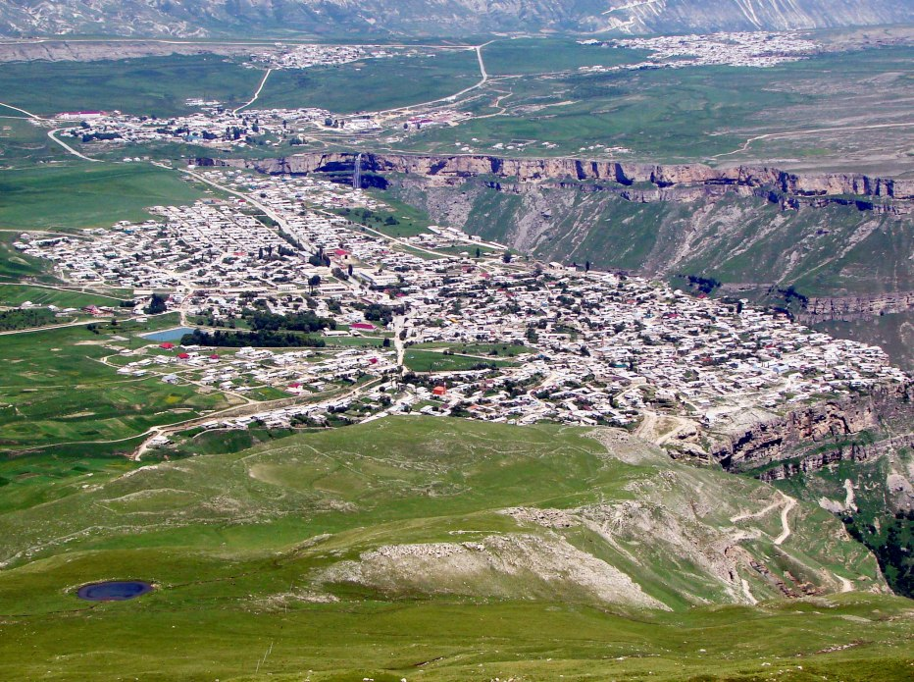
Case and agreement
A morphologist should be able to describe the word-structure of the languages around them, wherever in the world they are.
Image credit: Wikimedia

Slide 7
A lot of case in the Caucasus
How many morphological cases?
Vietnamese: 0
Icelandic: 4
Turkish: 6
Russian: 6 (sometimes 7)
Avar: 19
Lak: 20
Hungarian: 21
Tabasaran: 48

Slide 8
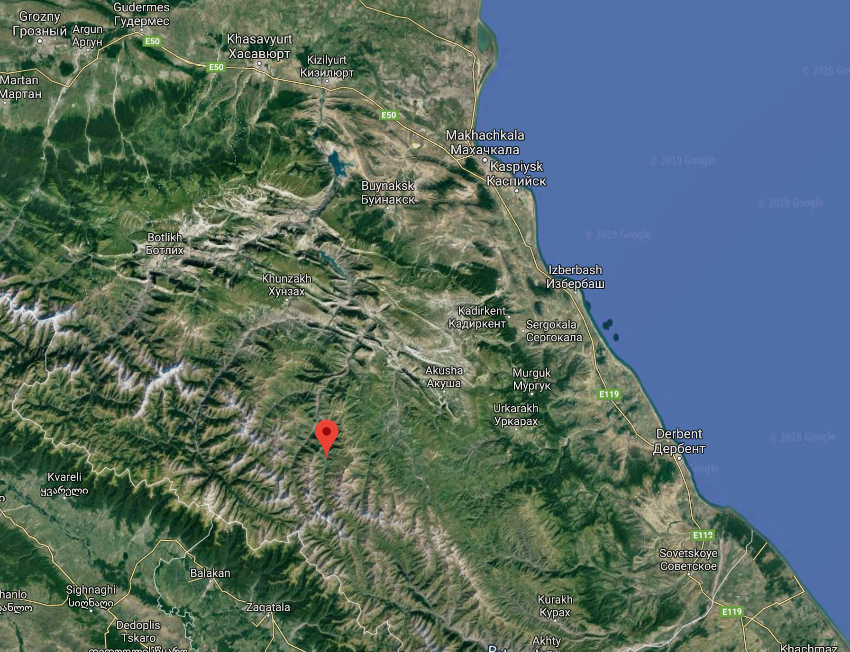
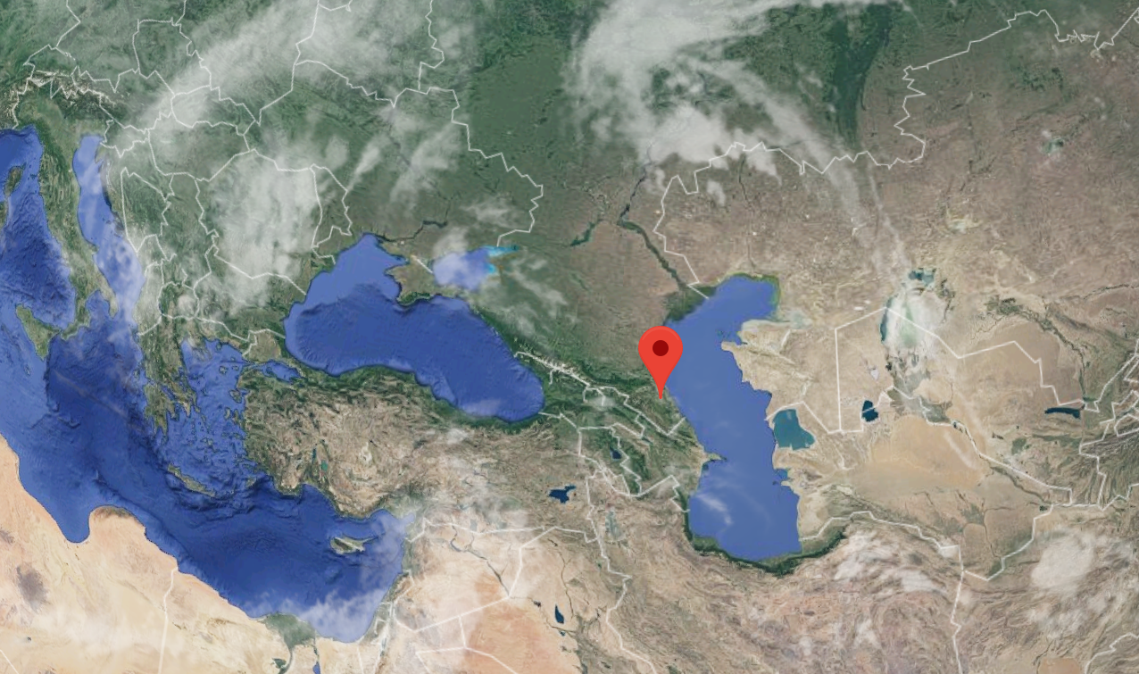
ARCHI
Archi is an East Caucasian language spoken in the Republic of Dagestan, which is located in the South of Russia.
Archi is spoken by around ~1200 people.
Archi is mostly spoken in the village of Archib.
Archi is also an ergative language, but with a twist.

Slide 9
ARCHI
wez dija tɬ’anʃi wi ‘I like father.’
bez dogi tɬ’anʃi bi ‘I like the donkey.’
dez buwa tɬ’anʃi di ‘I like mother.’
ez motol tɬ’anʃi i ‘I like the young goat.’
Kibrik 1977

Slide 10
ARCHI
wez dija tɬ’anʃi wi ‘I like father.’
bez dogi tɬ’anʃi bi ‘I like the donkey.’
dez buwa tɬ’anʃi di ‘I like mother.’
ez motol tɬ’anʃi i ‘I like the young goat.’
Archi has four genders:
dija ‘father’ is in the w-gender class (Class I).
buwa ‘mother’ is in the d-gender class (Class II).
dogi ‘donkey’ is in the b-gender class (Class III).
motol ‘young goat’ is in the zero-gender class (Class IV).
Kibrik 1977

Slide 11
ARCHI
w-ez dija tɬ’an-ʃi w-i
I-me.DAT father.ABS like-PRS I-be.PRS
‘I like father.’
b-ez dogi tɬ’an-ʃi b-i III-me.DAT donkey.ABS like-PRS III-be.PRS ‘I like the donkey.’
d-ez buwa tɬ’an-ʃi d-i II-me.DAT mother.ABS like-PRS II-be.PRS ‘I like mother.’
ez motol tɬ’an-ʃi i
IV-me.DAT father.ABS like-PRS IV.be.PRS
‘I like the young goat.’
Kibrik 1977

Slide 12
ARCHI
w-ez dija tɬ’an-ʃi w-i
I-me.DAT father.ABS like-PRS I-be.PRS
‘I like father.’
b-ez dogi tɬ’an-ʃi b-i III-me.DAT donkey.ABS like-PRS III-be.PRS ‘I like the donkey.’
d-ez buwa tɬ’an-ʃi d-i II-me.DAT mother.ABS like-PRS II-be.PRS ‘I like mother.’
ez motol tɬ’an-ʃi i
IV-me.DAT father.ABS like-PRS IV.be.PRS
‘I like the young goat.’
Masculine agreement on me!
Kibrik 1977

Slide 13
ARCHI
w-ez dija tɬ’an-ʃi w-i
I-me.DAT father.ABS like-PRS I-be.PRS
‘I like father.’
b-ez dogi tɬ’an-ʃi b-i III-me.DAT donkey.ABS like-PRS III-be.PRS ‘I like the donkey.’
d-ez buwa tɬ’an-ʃi d-i II-me.DAT mother.ABS like-PRS II-be.PRS ‘I like mother.’
ez motol tɬ’an-ʃi i
IV-me.DAT father.ABS like-PRS IV.be.PRS
‘I like the young goat.’
Feminine agreement on me!
Kibrik 1977

Slide 14
ARCHI
w-ez dija tɬ’an-ʃi w-i
I-me.DAT father.ABS like-PRS I-be.PRS
‘I like father.’
b-ez dogi tɬ’an-ʃi b-i III-me.DAT donkey.ABS like-PRS III-be.PRS ‘I like the donkey.’
d-ez buwa tɬ’an-ʃi d-i II-me.DAT mother.ABS like-PRS II-be.PRS ‘I like mother.’
ez motol tɬ’an-ʃi i
IV-me.DAT father.ABS like-PRS IV.be.PRS
‘I like the young goat.’
Class-III neuter agreement on me!
Kibrik 1977

Slide 15
Case and agreement
“What's the difference between case and agreement?”
Sharon write-s to me Sharon.NOM write-3SG to 1SG.ACC
Case marks arguments.
Agreement marks verbs.
…usually… except in Archi agreement also marks arguments!

Slide 16
Case and agreement
English pattern:
I write to Sharon 1SG.NOM write to Sharon.ACC
Archi pattern:
to me-s write-s Sharon to 1SG.DAT-3SG write-3SG Sharon.ABS

Slide 17
Case and agreement
“What's the difference between case and agreement?”
Agreement has a controller which is usually a noun. The features of the controller noun spread to the target, which is usually (but not always) a verb!
Corbett 2005

Slide 18
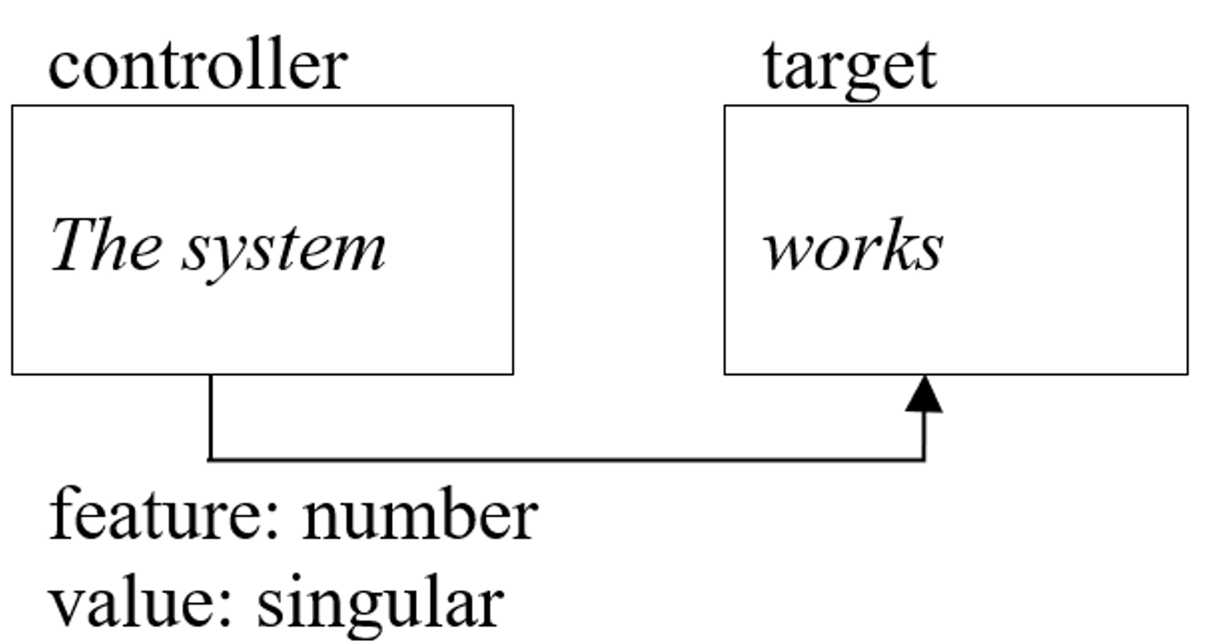
Case and agreement
“What's the difference between case and agreement?”
Agreement has a controller which is usually a noun. The features of the controller noun spread to the target, which is usually (but not always) a verb!
Corbett 2005

Slide 19
Case and agreement
“What's the difference between case and agreement?”
Agreement has a controller which is usually a noun. The features of the controller noun spread to the target, which is usually (but not always) a verb!
Case has a controller which is usually a verb (including phrasal verbs) or adposition. The target of case is usually a noun! E.g.:
I talked with him. (would be comitative case)
I talked to him. (would be dative case)
Corbett 2005

Slide 20
urʃi wak’ib ‘The boy came.’
rurʃi rak’ib ‘The girl came.’
xæ bak’ib ‘The dog came.’

Slide 21
urʃi wak’ib ‘The boy came.’
rurʃi rak’ib ‘The girl came.’
xæ bak’ib ‘The dog came.’
ilini urʃi tʃeʔib ‘(S)he saw the boy.’
ilini rurʃi tʃreʔib ‘(S)he saw the girl.’
ilini xæ tʃbeʔib ‘(S)he saw the dog.’

Slide 22
DARGI
urʃi wak’ib ‘The boy came.’
rurʃi rak’ib ‘The girl came.’
xæ bak’ib ‘The dog came.’
ilini urʃi tʃeʔib ‘(S)he saw the boy.’
ilini rurʃi tʃreʔib ‘(S)he saw the girl.’
ilini xæ tʃbeʔib ‘(S)he saw the dog.’

Slide 23
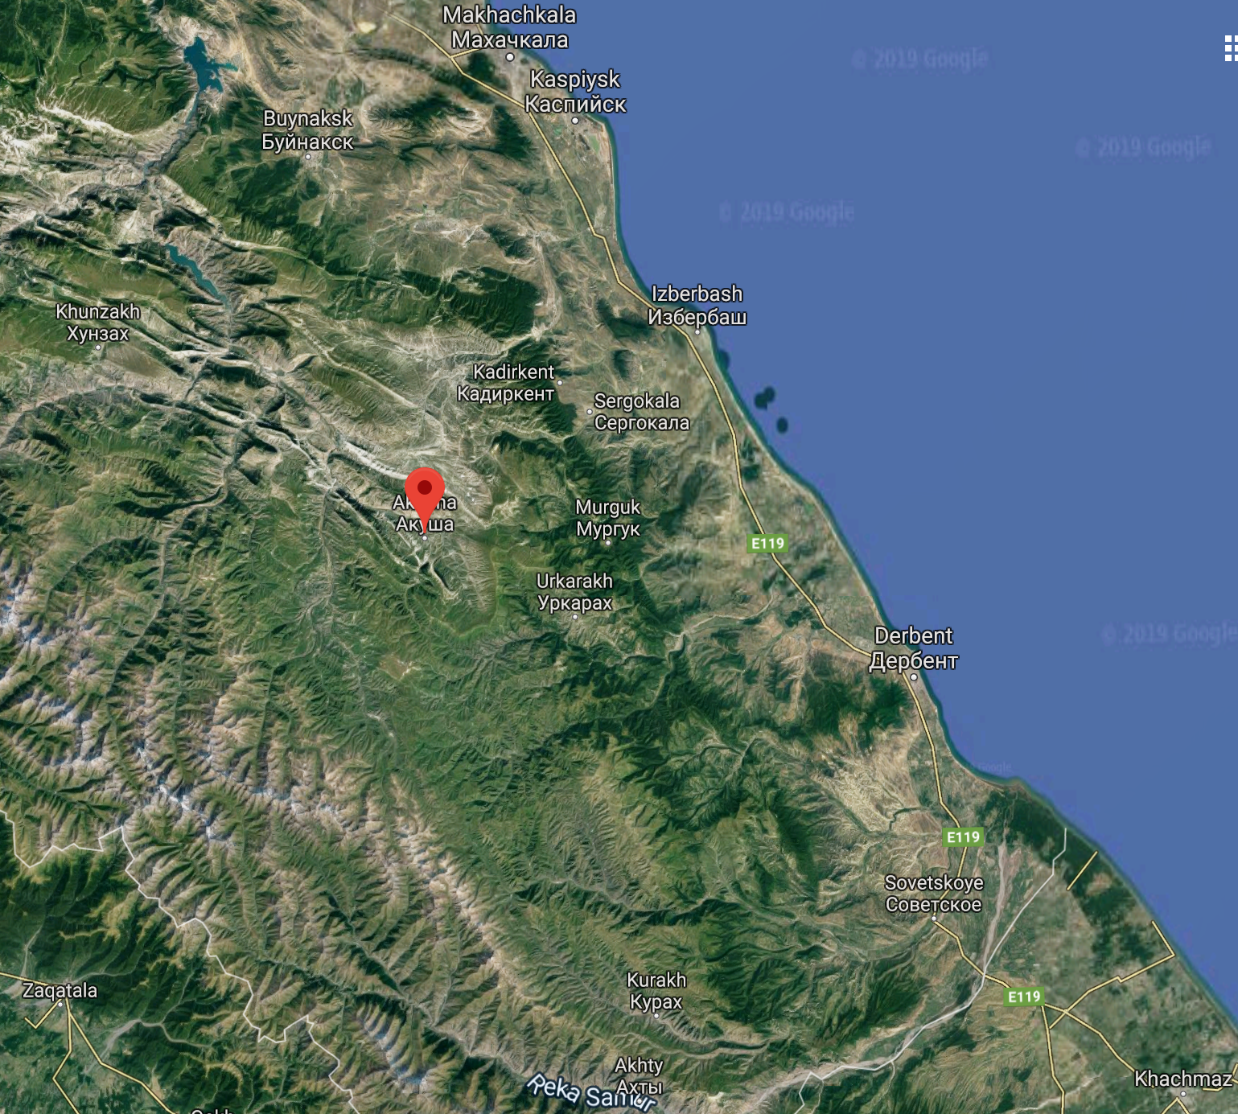
DARGI
Dargi is an East Caucasian language spoken in the Republic of Dagestan, which is located in the South of Russia.
Dargi is spoken by 366,000 people.
The standard dialect of Dargi is based on the version of the language spoken in the village of Akusha.
Dargi is an ergative language.

Slide 24
Recap: Ergativity
DARGI
urʃi w-ak’-ib boy.ABS I-come-AOR.3 ‘The boy came.’
il.i-ni rurʃi tʃ<r>eʔ-ib (s)he-ERG girl.ABS see<II>-AOR.3 ‘(S)he saw the girl.’
il.i-ni xæ tʃ<b>eʔ-ib (s)he-ERG dog.ABS see<III>-AOR.3 ‘(S)he saw the dog.’
From van den Berg 2005

Slide 25
Recap: Ergativity
DARGI
urʃi w-ak’-ib boy.ABS I-come-AOR.3 ‘The boy came.’
il.i-ni rurʃi tʃ<r>eʔ-ib (s)he-ERG girl.ABS see<II>-AOR.3 ‘(S)he saw the girl.’
il.i-ni xæ tʃ<b>eʔ-ib (s)he-ERG dog.ABS see<III>-AOR.3 ‘(S)he saw the dog.’
Infixes which mark agreement!
From van den Berg 2005

Slide 26
Recap: Ergativity
In nominative-accusative systems, S (subject of an intransitive verb) and A (subject of a transitive verb) are encoded identically, and this encoding differs from that of P (patient-like argument of a transitive verb).
Who does what to whom can be encoded by… case marking, verb agreement, incorporation, etc. E.g.: She sleeps. [S=she=NOM] She loves a few good New York slices. [A=she=NOM] The people love her. [P=her=ACC]
In neutral systems, all arguments are encoded in the same way.
In ergative-absolutive systems, S is encoded in the same way as P, and this encoding differs from that of A.

Slide 27
Recap: Ergativity
In nominative-accusative systems, S (subject of an intransitive verb) and A (subject of a transitive verb) are encoded identically, and this encoding differs from that of P (patient-like argument of a transitive verb).
In neutral systems, all arguments are encoded in the same way.
Who does what to whom can be encoded by… case marking, verb agreement, incorporation, etc. E.g.: Her sleeps. [S=she] Her loves a few good New York slices. [A=she] The people love her. [P=her]
In ergative-absolutive systems, S is encoded in the same way as P, and this encoding differs from that of A.

Slide 28
Recap: Ergativity
In nominative-accusative systems, S (subject of an intransitive verb) and A (subject of a transitive verb) are encoded identically, and this encoding differs from that of P (patient-like argument of a transitive verb).
In neutral systems, all arguments are encoded in the same way.
In ergative-absolutive systems, S is encoded in the same way as P, and this encoding differs from that of A.
Who does what to whom can be encoded by… case marking, verb agreement, incorporation, etc. E.g.: She sleeps. [S=she=ABS] Her love a few good New York slices. [A=she=ERG] The people loves she. [P=she=ACC]

Slide 29
Recap: Ergativity
Ergativity is one way of aligning morphology and syntax in the encoding of who did what to whom.

Slide 30
Recap: Ergativity
Ergativity is one way of aligning morphology and syntax in the encoding of who did what to whom.
There are many other kinds of ergativity in the Caucasus. Many of them don’t play by the same rules…

Slide 31
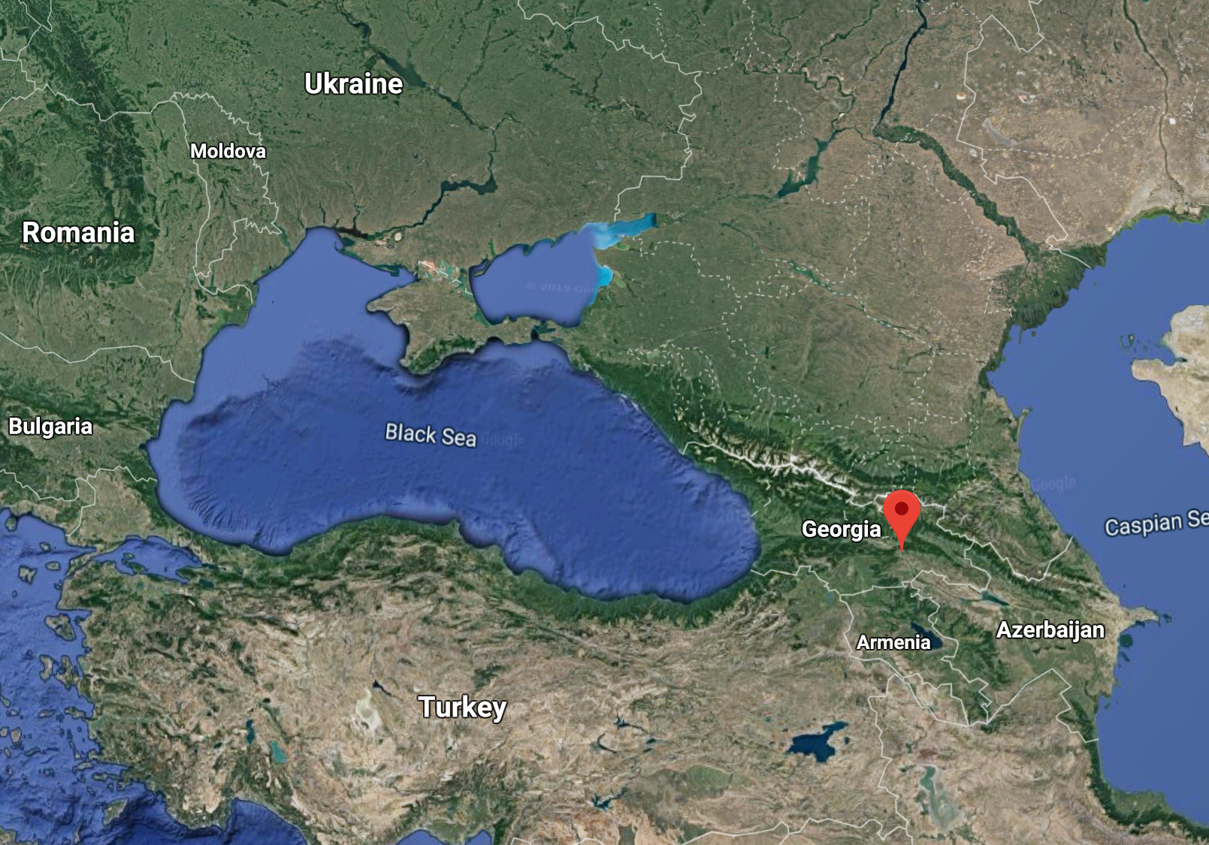
GEORGIAN
Georgian is a South Caucasian (Kartvelian) language spoken in the Republic of Georgia (no, not in Atlanta).
Georgian is spoken by around 3.7 million people.
Georgian is sometimes called a ‘split-ergative’ language.

Slide 32
GEORGIAN
ვანომ ითამაშა
vanom itamaʃa
‘Vano played.’
ნინომ დაამთქნარა
ninom daamtknara ‘Nino yawned.’
ვანომ იფიქრა მარიკაზე
vanom ipikra marikaze ‘Vano thought about Marika.’
Harris 1981

Slide 33
GEORGIAN
ვანომ ითამაშა
vano-m itamaʃa
Vano-ERG he.played.II.3
‘Vano played.’
ნინომ დაამთქნარა
nino-m daamtknara Nino-ERG she.yawned.II.1 ‘Nino yawned.’
ვანომ იფიქრა მარიკაზე
vano-m ipikra marikaze Vano-NOM he.thought.II.3 Marika.LOC ‘Vano thought about Marika.’
Harris 1981

Slide 34
GEORGIAN
ვანომ ითამაშა
vano-m itamaʃa
Vano-ERG he.played.II.3
‘Vano played.’
ნინომ დაამთქნარა
nino-m daamtknara Nino-ERG she.yawned.II.1 ‘Nino yawned.’
ვანომ იფიქრა მარიკაზე
vano-m ipikra marikaze Vano-NOM he.thought.II.3 Marika.LOC ‘Vano thought about Marika.’
ვანო აღიღინდა
vano aɣiɣinda
Vano.ABS came.about.croon.II.2
‘Vano began to sing in a low voice.’
გლეხმა დათესა სიმინდი
glex-ma datesa simind-i
farmer-ERG he.sowed.it.II.1 corn-ABS ‘The farmer sowed corn.’
დედამ აკოცა შვილს
deda-m ak’otsa ʃvil-s mother-ERG she.kissed.him.II.1 child-DAT ‘The mother kissed her child.’
Harris 1981

Slide 35
GEORGIAN
ბავშვი მიესალმა დედას
bavʃv-i miesalma deida-s child-ABS he.greeted.her.II.2 aunt-DAT ‘The child greeted (his) aunt.’
Harris 1981

Slide 36
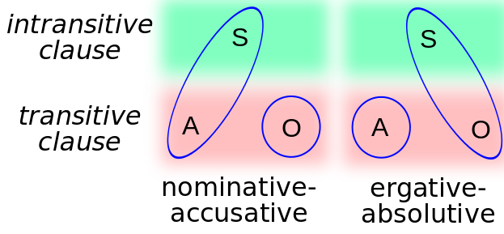
Canonical ergativity
Image source: Wikimedia commons
begin to sing
played
yawned
thought about
sow/plant
kiss
greet

Slide 37
Canonical ergativity
Image source: Wikimedia commons
Intransitive (subject=S) begin to sing
played
yawned
thought about
Transitive (subject=A)
sow/plant
kiss
greet

Slide 38
Canonical ergativity
Image source: Wikimedia commons
Georgian Ergative (subject=Active)
Intransitive (subject=S) begin to sing
played
yawned
thought about
Transitive (subject=A)
sow/plant
kiss
greet

Slide 39
Canonical ergativity
Image source: Wikimedia commons
Georgian Ergative (subject=Active)
Intransitive (subject=S) begin to sing
played
yawned
thought about
Transitive (subject=A)
sow/plant
kiss
greet
Georgian Nominative/Absolutive (subject=Stative)

Slide 40
GEORGIAN
ვანომ ითამაშა
vano-m itamaʃa
Vano-ERG he.played.II.3
‘Vano played.’
ვანო თამაშობს vano tamaʃobs
Vano.ABS he.plays.II.3
‘Vano plays.’
დედამ აკოცა შვილს
deda-m ak’otsa ʃvil-s mother-ERG she.kissed.him.II.1 child-DAT ‘The mother kissed her child.’
დედა კოცნის შვილს
deda k’otsnis ʃvil-s mother.ABS she.kisses.him.II.1 child-DAT ‘The mother kisses her child.’

Slide 41
GEORGIAN
ვანომ ითამაშა
vano-m itamaʃa
Vano-ERG he.played.II.3
‘Vano played.’
ვანო თამაშობს vano tamaʃobs
Vano.NOM he.plays.II.3
‘Vano plays.’
დედამ აკოცა შვილს
deda-m ak’otsa ʃvil-s mother-ERG she.kissed.him.II.1 child-DAT ‘The mother kissed her child.’
დედა კოცნის შვილს
deda k’otsnis ʃvil-s mother.NOM she.kisses.him.II.1 child-DAT ‘The mother kisses her child.’

Slide 42
Canonical ergativity
Image source: Wikimedia commons
Intransitive (subject=S) begin to sing
played
yawned
thought about
Transitive (subject=A)
sow/plant
kiss
greet
Georgian Ergative (subject=Active; aspect=perfective)
Georgian Nominative/Absolutive (subject=Stative)

Slide 43
Split-ergativity
Ergativity is one way of aligning morphology and syntax in the encoding of who did what to whom.
But some languages split when they mark ergativity along other linguistic features. Georgian splits ergative marking along the following two features:
Putting an ergative case marker on the subject of an active verb (like sow, kiss, begin to sing, play, yawn), but not on the subject of an inactive/stative verb (greet, think about). Sometimes this kind of split is referred to as ‘Active-Inactive alignment.’

Slide 44
Split-ergativity
Ergativity is one way of aligning morphology and syntax in the encoding of who did what to whom.
But some languages split when they mark ergativity along other linguistic features. Georgian splits ergative marking along the following two features:
Putting an ergative case marker on the subject of an active verb (like sow, kiss, begin to sing, play, yawn), but not on the subject of an inactive/stative verb (greet, think about). Sometimes this kind of split is referred to as ‘Active-Inactive alignment.’
Putting an ergative case marker on the subject of an active verb in the perfective aspect but not in the imperfective aspect.
Other split-ergative/active-inactive languages, like Basque, mark ergativity in all aspects except the progressive, in which subjects must be marked by the nominative case.

Slide 45
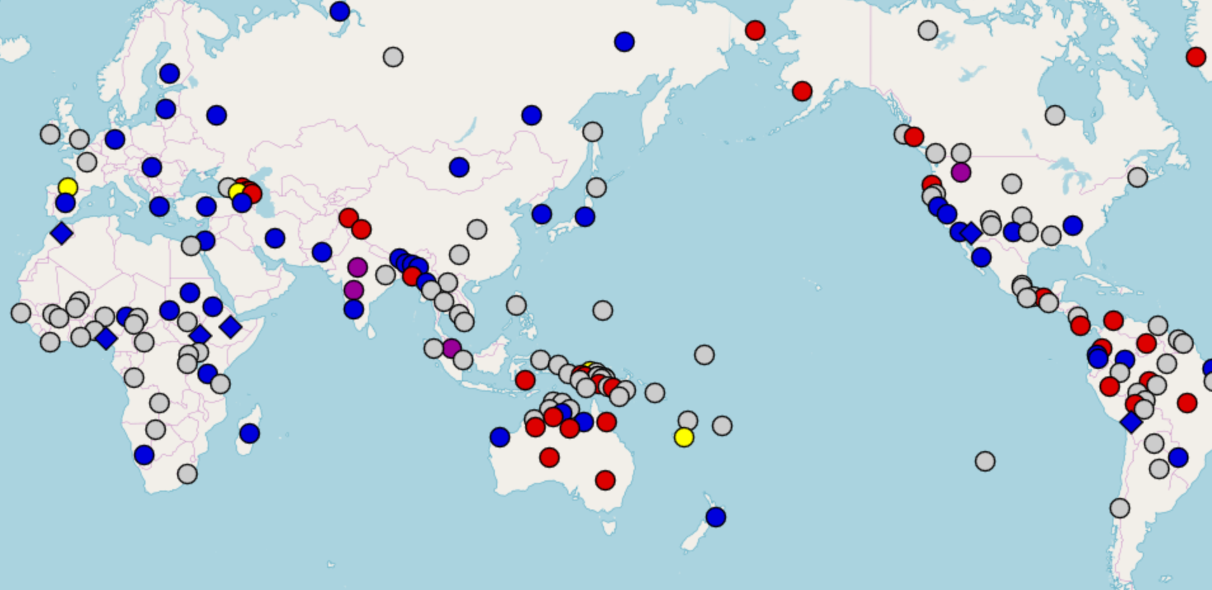
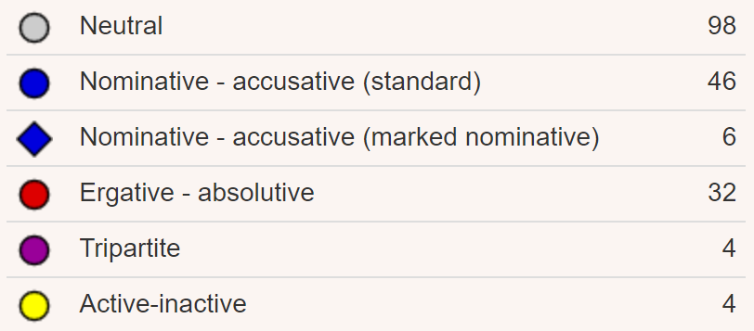
Morphosyntactic alignment patterns
From the WALS database chapter on morphosyntactic alignment patterns.

Slide 46
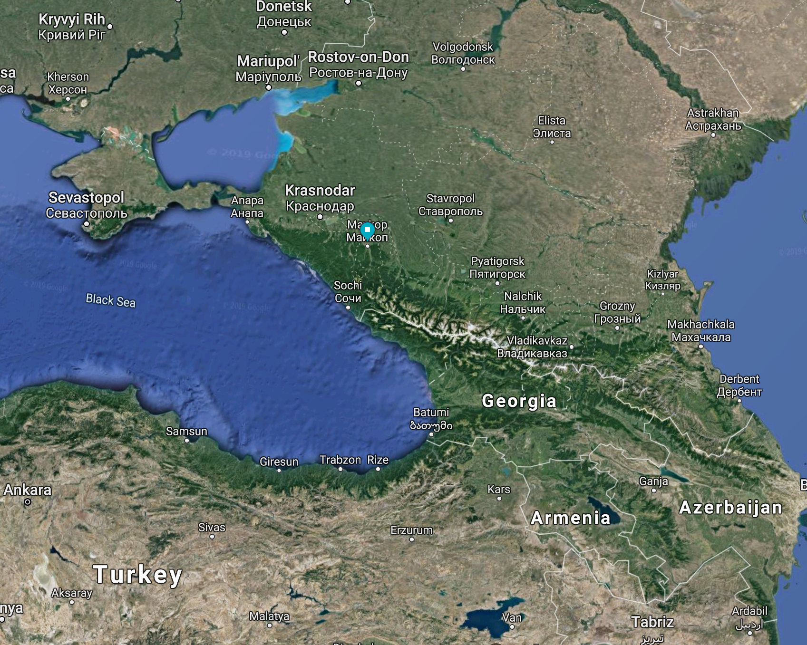
ADYGHE (West Caucasian)
Adyghe is an ergative-absolutive language. It marks the plural with the suffix -χe, except when the noun marked by the ergative -m; then it has a more specific suffix:
bostej-χe-r dress-PL-ABS ‘dresses’ (absolutive)
hatʃ’e-m-e guest-ERG-ERG.PL ‘guests’ (ergative)
Kumakhov et al. 1996: 4; Harris 2017

Slide 47
ADYGHE (West Caucasian)
Unlike perhaps most nouns, pronouns in Adyghe may bring two ergative suffixes to the party: -m and -ʃ’
a-χe-m he-PL-ERG ‘they’ (ergative)
a-ʃ’-m-e he-ERG-ERG-ERG.PL ‘they’ (ergative)
Kumakhov et al. 1996: 2-3; Harris 2017

Slide 48
ADYGHE (West Caucasian)
Unlike perhaps most nouns, pronouns in Adyghe may bring two ergative suffixes to the party: -m and -ʃ’
a-χe-m he-PL-ERG ‘they’ (ergative)
a-ʃ’-m-e he-ERG-ERG-ERG.PL ‘they’ (ergative)
But the only good parties are the ones where you both bring your friends:
a-χe-m-e he-PL-ERG-ERG.PL ‘they’ (ergative)
a-ʃ’-χe-m-e he-ERG-PL-ERG-ERG.PL ‘they’ (ergative)
a-r-χe-m-e he-ABS-PL-ERG-ERG.PL ‘they’ (ergative)
Kumakhov et al. 1996: 4; Harris 2017

Slide 49
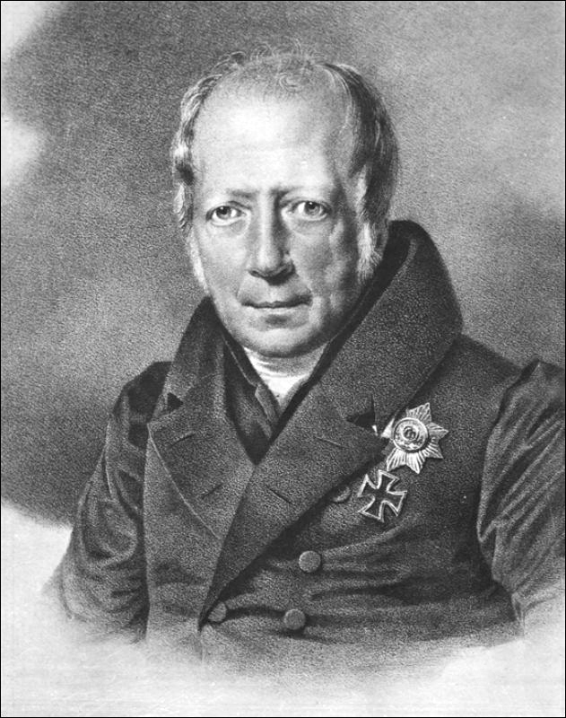
Humboldt’s Universal (von Humboldt 1836/1839)
Suppletion is undesirable.
Uniformity of linguistic symbolization is desirable: Both roots and grammatical markers should be unique and constant.
Image source: Wikimedia commons
See Vennemann 1972: 184 for more information.

Slide 50
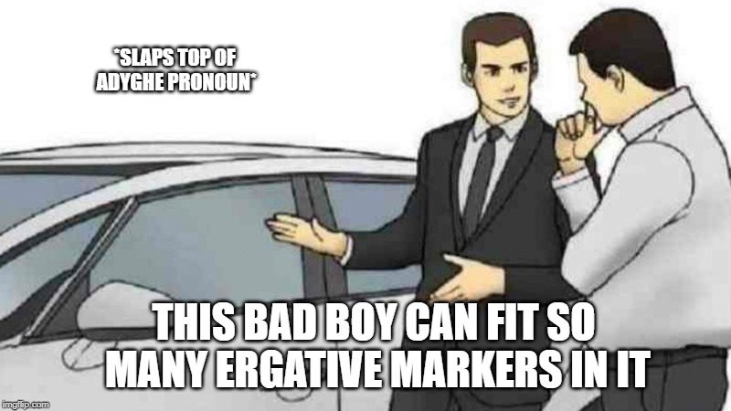
ADYGHE (West Caucasian)
Can one really ever have too much ergativity?
aχeme
aχem
aʃ’χeme
arχeme
aʃ’me

Slide 51
ADYGHE (West Caucasian)
L
Can one really ever have too much ergativity?
Ergativity in Adyghe isn’t uniquely marked… nor is it constant…
aχeme
aχem
aʃ’χeme
Image source: Wikimedia commons
arχeme
aʃ’me

Slide 52
ENGLISH
I/you/ya’ll/they/we sail the Seven Seas in search of treasure.
I/you/ya’ll/they/we sailed the Seven Seas in search of treasure.

Slide 53
ENGLISH
I/you/ya’ll/they/we sail the Seven Seas in search of treasure.
I/you/ya’ll/they/we sailed the Seven Seas in search of treasure.
John sails the Seven Seas in search of treasure.
John sailed the Seven Seas in search of treasure.

Slide 54
ENGLISH
to sail
Present & third person singular
Present & non-third person singular
Past
sail-s
sail-ø
sail-ed
Note: -ø does not mean there is a real suffix there. It is a zero-marker we can use to distinguish when an affixless form contrasts with an affixed form.

Slide 55
ENGLISH
to sail
Present & third person singular
Present & non-third person singular
Past
J
sail-s
sail-ø
sail-ed
Note: -ø does not mean there is a real suffix there. It is a zero-marker we can use to distinguish when an affixless form contrasts with an affixed form.

Slide 56
ENGLISH
to sail
Present & third person singular
Present & non-third person singular
Past
J
K
sail-s
sail-ø
sail-ed
Note: -ø does not mean there is a real suffix there. It is a zero-marker we can use to distinguish when an affixless form contrasts with an affixed form.

Slide 57
ENGLISH
to sail
J
Present & third person singular
Present & non-third person singular
Past
J
K
sail-s
sail-ø
sail-ed
Note: -ø does not mean there is a real suffix there. It is a zero-marker we can use to distinguish when an affixless form contrasts with an affixed form.

Slide 58
ENGLISH
to sail
Hey these person and number features aren’t uniquely marked in the morphology, pls fix
J
Present & third person singular
Present & non-third person singular
Past
J
K
sail-s
sail-ø
sail-ed
Note: -ø does not mean there is a real suffix there. It is a zero-marker we can use to distinguish when an affixless form contrasts with an affixed form.

Slide 59
ENGLISH
to sail
J
Present & third person singular
Present & non-third person singular
Past
J
K
sail-s
sail-ø
sail-ed
Note: -ø does not mean there is a real suffix there. It is a zero-marker we can use to distinguish when an affixless form contrasts with an affixed form.

Slide 60
ENGLISH
John sail[d] the Seven Seas in search of treasure.
John tap[t] his desk with a pencil.
John shred[ıd] the documents.

Slide 61
ENGLISH
J
to sail
Past
sail-[d]

Slide 62
ENGLISH
J
to sail
to tap
Past
Past
sail-[d]
tap-[t]

Slide 63
ENGLISH
J
to sail
to tap
to shred
Past
Past
Past [suffix]
sail-[d]
tap-[t]
shred-[ıd]

Slide 64
ENGLISH
John sail[d] the Seven Seas in search of treasure.
John tap[t] his desk with a pencil.
John shred[ıd] the documents.
John sinks the ships of his enemies.
John sank the ships of his enemies.

Slide 65
ENGLISH
K
to sail
to tap
to shred
to sink
Past [suffix]
Past [suffix]
Past [suffix]
Past [ablaut]
sail-[d]
tap-[t]
shred-[ıd]
sank

Slide 66
ENGLISH
John sail[d] the Seven Seas in search of treasure.
John tap[t] his desk with a pencil.
John shred[ıd] the documents.
John sinks the ships of his enemies.
John sank the ships of his enemies.
John sleeps very late every morning.
John slept very late every morning.

Slide 67
ENGLISH
L
to sail
to tap
to shred
to sink
to sleep
Past [suffix]
Past [suffix]
Past [suffix]
Past [ablaut]
sail-[d]
tap-[t]
shred-[ıd]
sank
slep-[t]

Slide 68
ENGLISH
L
to sail
to tap
to shred
to sink
to sleep
MULTIPLE EXPONENCE
Past [suffix]
Past [suffix]
Past [suffix]
Past [ablaut]
sail-[d]
tap-[t]
shred-[ıd]
sank
slep-[t]

Slide 69
Single exponence and multiple exponence
Single exponence is is the occurrence of a single realization of a single morphosemantic feature, bundle of features, or derivational category within a word. e.g.: sank, sailed, spoke

Slide 70
Single exponence and multiple exponence
Single exponence is is the occurrence of a single realization of a single morphosemantic feature, bundle of features, or derivational category within a word. e.g.: sank, sailed, spoke
Multiple exponence is the occurrence of multiple realizations of a single morphosemantic feature, bundle of features, or derivational category within a word.
e.g.: slept, felt; aʃ’me, aχeme, aʃ’χeme, arχeme
Harris 2017: 9

Slide 71
Single exponence and multiple exponence
Multiple exponence has nothing to do with ergativity in particular, but some languages, like Adyghe, have multiple exponence in its ergative marking. Multiple exponence is thought to be rare in the languages of the world (though we have it in past tense marking in English), but it is a phenomenon found in many languages in the Caucasus, with different kinds of features.
Harris 2017: 9

Slide 72
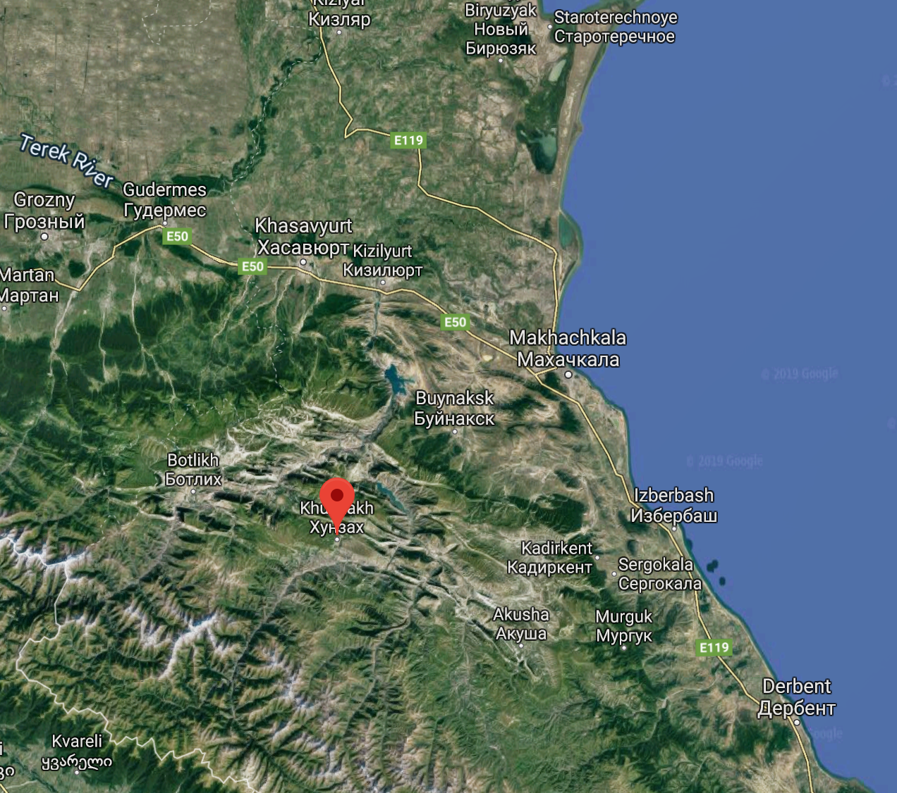
AVAR
Like Dargi and Archi, Avar is an East Caucasian language spoken in the Republic of Dagestan.
Avar is spoken by ~1 million people.
The standard dialect of Avar is based on the version of the language spoken in the village of Khunzakh.
Avar has 3 genders in the singular: masculine, feminine, and neuter.

Slide 73
Multiple exponence AVAR
There are three genders in the singular, which are collapsed in the plural. Gender and number agreement is marked on adjectives.
херав
xer-av old-MASC ‘old’ (masculine)
херай
xer-aj old-FEM ‘old’ (feminine)
хераб
xer-ab old-NEUT ‘old’ (neuter)
херал
xer-al old-PL ‘old’ (plural)
Čikobava and Cercvaje 1962: 195-196; Harris 2017

Slide 74

Multiple exponence AVAR
Мэтт в-уго ц1акъ вац|ц|адав чи
Mɛtt v-ugo ts’aqχːʼ v-ats’:ad-av tʃi Matt.MASC.ABS MASC-be very MASC-clean-MASC person ‘Matt is a very clean person’

Slide 75
Multiple exponence AVAR
There are three genders in the singular, which are collapsed in the plural. Gender and number agreement is marked on adjectives.
херав
xer-av old-MASC ‘old’ (masculine)
херай
xer-aj old-FEM ‘old’ (feminine)
хераб
xer-ab old-NEUT ‘old’ (neuter)
херал
xer-al old-PL ‘old’ (plural)
But sometimes Avar adjectives have long forms, which have multiple markers of agreement:
вац|ц|адав
v-ats’:ad-av MASC-clean-MASC ‘clean’ (masculine)
яц|ц|адай
j-ats’:ad-aj FEM-clean-FEM ‘clean’ (feminine)
б-ац|ц|адаб
b-ats’:ad-ab NEUT-clean-NEUT ‘clean’ (neuter)
р-ац|ц|адал
r-ats’:ad-al PL-clean-PL ‘clean’ (plural)
Čikobava and Cercvaje 1962: 195-196; Harris 2017

Slide 76
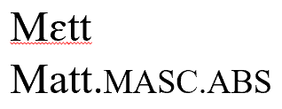
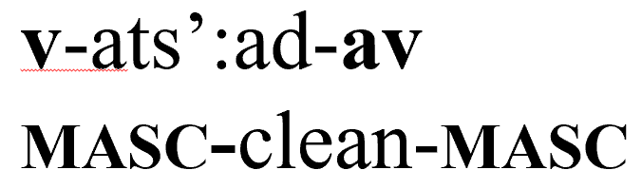
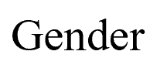
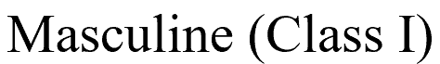
Multiple exponence AVAR
Мэтт в-уго ц1акъ вац|ц|адав чи
Mɛtt v-ugo ts’aqχːʼ v-ats’:ad-av tʃi Matt.MASC.ABS MASC-be very MASC-clean-MASC person ‘Matt is a very clean person’

Slide 77
Multiple exponence AVAR
OLD xer
J
Masculine
Feminine
Neuter
Plural
-av
-aj
-ab
-al

Slide 78
Multiple exponence AVAR
OLD xer
K
CLEAN ats’:ad
Masculine
Feminine
Neuter
Plural
Masculine
Feminine
Neuter
Plural
-av
-aj
-ab
-al
v-...-av
j-...-aj
b-...-ab
r-...-al

Slide 79
Multiple exponence AVAR
OLD xer
K
CLEAN ats’:ad
K
Well these agreement markers aren’t constantly marked, since sometimes adjectives take suffixes, and sometimes they take circumfixes… but at least they are always uniquely marked.
Masculine
Feminine
Neuter
Plural
Masculine
Feminine
Neuter
Plural
-av
-aj
-ab
-al
v-...-av
j-...-aj
b-...-ab
r-...-al

Slide 80
Multiple exponence AVAR
OLD xer
K
CLEAN ats’:ad
K
Masculine
Feminine
Masculine
Feminine
Those aren’t circumfixes! All of those agreement markers independently occur as the suffixes -av, -aj, -ab, and -al. The agreement features are not uniquely marked!
Neuter
Plural
Neuter
Plural
-av
-aj
-ab
-al
v-...-av
j-...-aj
b-...-ab
r-...-al
L

Slide 81
Multiple exponence AVAR
OLD xer
L
CLEAN ats’:ad
L
Oh no, it’s multiple exponence!
Masculine
Feminine
Neuter
Plural
Masculine
Feminine
Neuter
Plural
-av
-aj
-ab
-al
v-...-av
j-...-aj
b-...-ab
r-...-al
L

Slide 82


Slide 83
What isn’t multiple exponence?
Sometimes we see multiple markers of the same thing, but that doesn’t make it multiple exponence.

Slide 84
Reduplication isn’t multiple exponence
ENGLISH
John is a very good pirate.
=/=
John is a very very good pirate.
=/=
John is a very very very good pirate.

Slide 85
Reduplication isn’t multiple exponence
ENGLISH
TURKISH
John is a very good pirate.
=/=
John is a very very good pirate.
=/=
John is a very very very good pirate.
enli ‘broad’
=/=
epenli ‘very broad’
ulu ‘great’
=/=
upulu ‘very great’
oyuk ‘hollow’ =/= opoyuk ‘very hollow’

Slide 86
Reduplication Turkish
Adjective = CV(C)X
Adjective = CV(C)X
Superlative ‘very’
Adjective
CVp-CV(C)X
CVp-CV(C)X

Slide 87
Reduplication Turkish
Adjective = CV(C)X
Adjective = CV(C)X
Superlative ‘very’
Adjective
CVp-CV(C)X
CVp-CV(C)X
Reduplication is not the multiple realization of the same semantic or morphological features. Reduplication is usually using syllable structure to mark a single feature, like superlatives.

Slide 88
Wrapping up
Some common ways of saying who does what to whom in the Caucasus are very different from the rest of the world…
Nouns can be targets for agreement (Archi!).

Slide 89
Wrapping up
Some common ways of saying who does what to whom in the Caucasus are very different from the rest of the world…
Nouns can be targets for agreement (Archi!).
Ergativity marks who does what to whom in a specific way, usually by marking the subject of a transitive verb, or also by agreeing with the object of a transitive clause instead of with the subject.

Slide 90
Wrapping up
Some common ways of saying who does what to whom in the Caucasus are very different from the rest of the world…
Nouns can be targets for agreement (Archi!).
Ergativity marks who does what to whom in a specific way, usually by marking the subject of a transitive verb, or also by agreeing with the object of a transitive clause instead of with the subject.
Split ergativity splits the ergativity-marking morphology along other parameters, like aspect, or the active/inactive distinction in verbs.

Slide 91
Wrapping up
Some common ways of saying who does what to whom in the Caucasus are very different from the rest of the world…
Nouns can be targets for agreement (Archi!).
Ergativity marks who does what to whom in a specific way, usually by marking the subject of a transitive verb, or also by agreeing with the object of a transitive clause instead of with the subject.
Split ergativity splits the ergativity-marking morphology along other parameters, like aspect, or the active/inactive distinction in verbs.
Multiple exponence is found crosslinguistically in various categories, including case marking and agreement.
Sometimes linguists predict that ME is never systematic (e.g. von Humboldt’s Principle, one form for one meaning). These predictions fail in the Caucasus!

Slide 92
Further reading
In English:
Corbett, Greville. 2005. Agreement. Cambridge: Cambridge University Press.
Harris, Alice C. 1981. Georgian Syntax. Cambridge: Cambridge University Press.
———. 2017. Multiple exponence. Oxford: Oxford University Press.
Kumakhov, Mukhadin, Karina Vamling, & Zara Kumakhova. 1996. Ergative case in the Circassian languages. Working Papers 45: 93–111. Lund: Lund University Department of Linguistics.
van den Berg, Helma. The East Caucasian language family. Lingua 115(2005): 147-190.
Vennemann, Theo. 1972. Phonetic and conceptual analogy. In Vennemann & Wilbur (eds.) Schuchardt, the neogrammarians, and the transformational theory of phonological change. Frankfurt: Athenaum.
In Georgian:
Čikobava, Arnold, and Ilia Cercvaje. 1962. Xunjuri ena. [The Avar language.] Tbilisi:
Universit’et’i.
In Russian:
Kibrik, Aleksandr E. 1977. Opyt strukturnogo opisanija arčinskogo jazyka. Tom II, Taksonomičeskaja grammatika. Moskva: Izdatel’stvo Moskovskogo Universiteta.

